Slide 1

Geometry Wrap Up

Slide 2
Area
A living room is 12’6” by 14’3”. Find the total square footage of laminate flooring needed for the given living room.
180.18 sq ft
178.13 sq ft
168 sq ft
53.8 sq ft

Slide 3
b) 12.5’ x 14.24’ = 178.13 sq ft

Slide 4
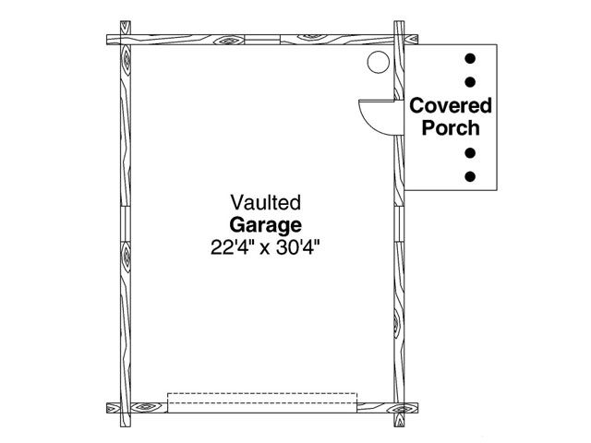
Perimeter
2. Determine the perimeter of the garage.
a) 680.96 feet
b) 105.6 inches
c) 677’4’’
d) 105’4”

Slide 5
d) 22’4” + 22’4” + 30’4” + 30”4” = 105’4”

Slide 6
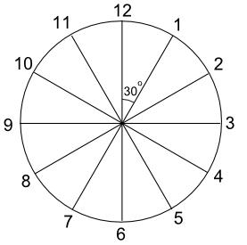
Interior Angles of a Circle
3. Using the clock diagram as a guide, find the measure of the angle
formed by the hands of a
clock when the clock shows
that the time is 2:30.
105°
120°
125°
45°

Slide 7

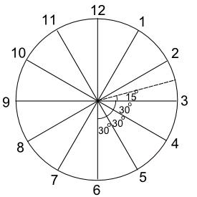
a) 15°+30°+30°+30°=105°

Slide 8
Perimeter Seating
4. The Quad Restaurant has square tables that seat one person on each side. To seat larger parties, two or more tables are pushed together. Determine the minimum number of tables needed to seat a party of 9.
a) 10
b) 9
c) 5
d) 4

Slide 9


9
8
7
1
6
2
3
4
5
d) 4 tables

Slide 10
Percentage Volume
5. When composting, the decaying process works best with a mixture that is 50% to 75% “brown” material- dried leaves, hay-like grass, and old prunings. The science teacher’s compost bin measures 36 inches wide, 36 inches deep, and 30 inches high. Determine the maximum volume in CUBIC FEET, of “brown” material for an appropriate compost mixture.
a) 16.88 ft³ b) 38880 ft³ c) 29160 ft³ d) 1080 ft³

Slide 11
Composting
Find volume of compost bin in cubic inches.
Volume=Length x width x height
38880 inches³=36”x 36” x 30”
Convert cubic inches to cubic feet.
1 cubic foot=12”x12”x12”=1728 inches³
38880 /1728=22.5 ft³
Find maximum volume of ‘brown” material if 50% to 75% works best in the decaying process.
22.5 ft³ x 75%=
22.5 ft³ x 0.75=16.88 ft³
a) 16.88 ft³

Slide 12
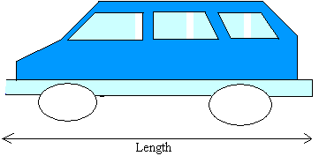
Scale
6. The length of a car is drawn to a scale of 1:20. If the length of car on the drawing is 12 inches, find the length of the actual car.
a) 20 inches
b) 32 inches
c) 240 inches
d) 420 inches

Slide 13

Scale of Car
The scale drawing and the actual object should be in the same proportion (similar objects). Thus, set up a proportion.
1 = 12 inches
20 x inches cross multiply to find x
c) x=240 inches

Slide 14
Right Triangles
7. Screens on electronic devices (TVs, smartphones, e-readers, etc.) are measured on the diagonal. If the length of a flat screen TV is 63 inches and the width is 16 inches, determine the diagonal measurement of the TV.
a) 63 inches
b) 16 inches
c) 79 inches
d) 65 inches

Slide 15
Pythagorean Theorem
The shape of the screen on a flat screen TV is rectangular. Draw a diagram of the given measurements.
Since the diagonal is the
hypotenuse of a right triangle,
use Pythagorean Theorem to solve.
16²+63²=4225, then √4225=65 inches
d) 65 inches
Diagonal
16”
63”

Slide 16
Trigonometry
8. A contractor builds a roof with a rise of 7.25 feet and a run of 18 feet. Find the pitch of the roof.
a) 7.25°
b) 22°
c) 0°
d) 68°

Slide 17
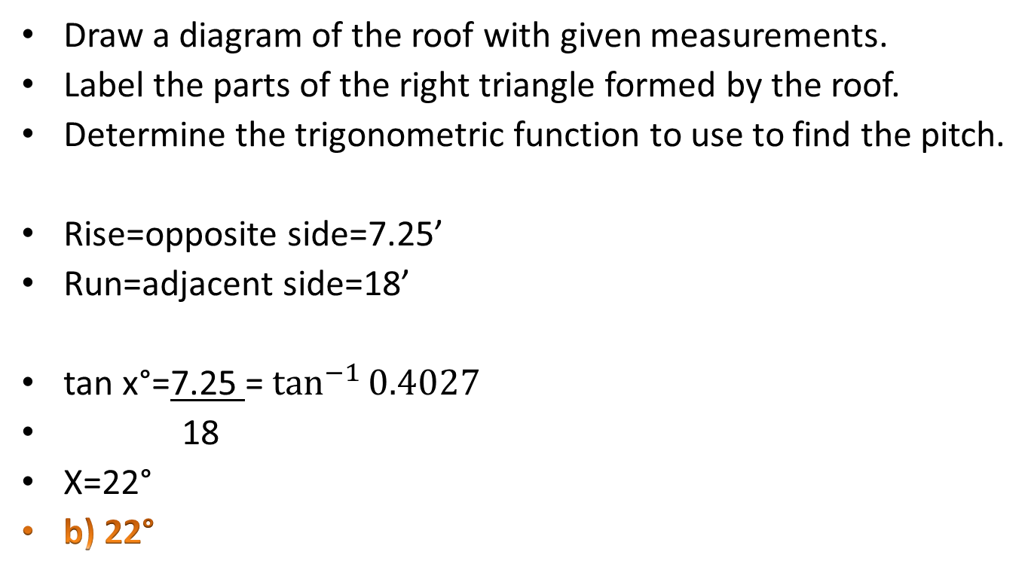
Roof Line Trig
Draw a diagram of the roof with given measurements.
Label the parts of the right triangle formed by the roof.
Determine the trigonometric function to use to find the pitch.
Rise=opposite side=7.25’
Run=adjacent side=18’
tan x°=7.25 = $\tan^{−1}{0.4027}$
18
X=22°
b) 22°
Rise=7.25’
Pitch=x°
Run=18’

Slide 18
Circles
9. Determine the size (area) of the drywall cut out for a circular electrical box with a diameter of 4”.
a) 12.5 square inches
b) 4 square inches
c) 16 square inches
d) 50.25 square inches

Slide 19
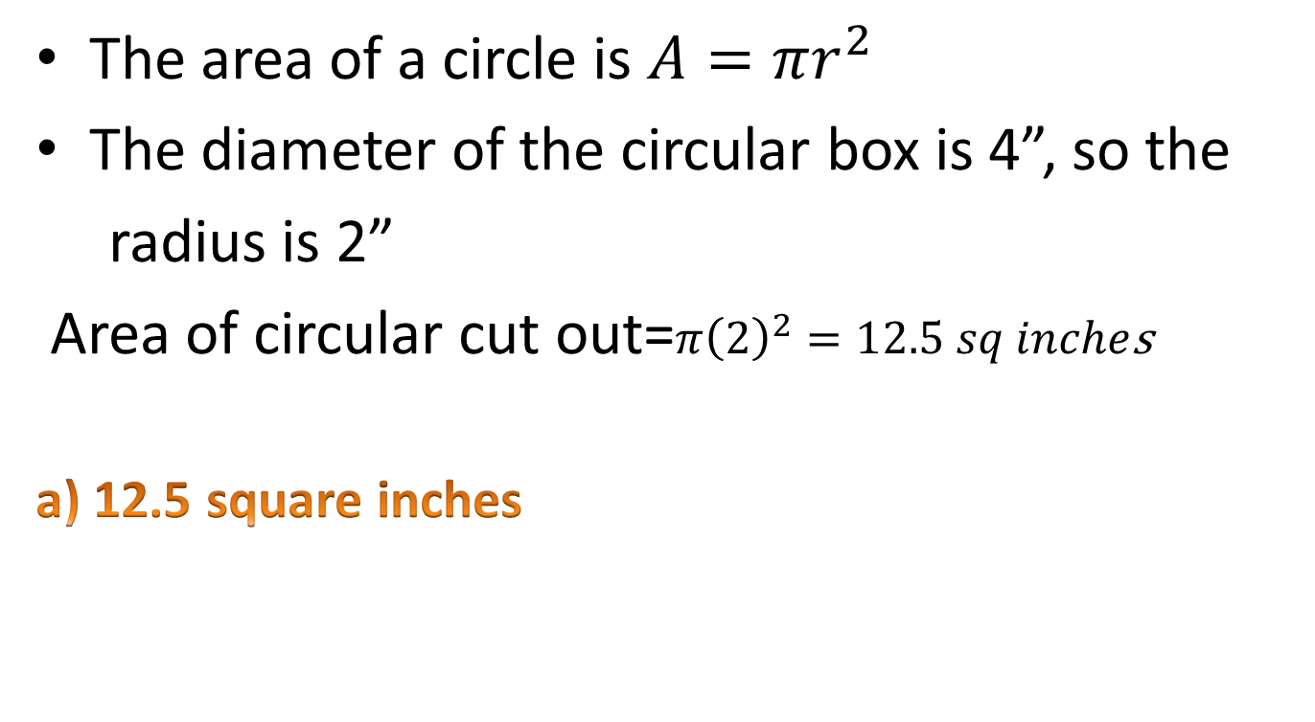
Circular Electrical Box Cut Outs
The area of a circle is $A=πr^{2}$
The diameter of the circular box is 4”, so the
radius is 2”
Area of circular cut out=$π{\left(2\right)}^{2}=12.5 sq inche$s
a) 12.5 square inches

Slide 20
Three Dimensional Objects
10. Describe the shape of the three-dimensional shape that can be folded from the diagram below.
a) cone
b) pyramid
c) tetrahedron
d) cylinder

Slide 21
Three Dimensional Objects
The attached net can be cut out and formed to create a cylinder.
d) cylinder

